Slide 1
Week 5
Assignment：Center Selection
Name：张颜兵
Id：12132428
Department：MAE
SuperVisor：Prof.吴雷
Research Topic：Engineering calculation

Slide 2

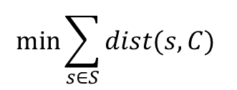
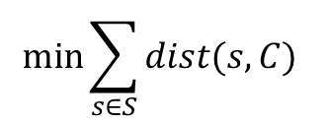
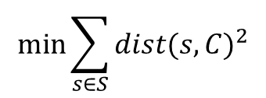
E1
$$min\max_{s∈S}{dist(s,C)}$$
0 1 2 3 4 5 6 7 8 9 10 11 12 13 14 15 16 17 18 19 20
$$min\sum_{s∈S}{dist{(s,C)}^{2}}$$
0 1 2 3 4 5 6 7 8 9 10 11 12 13 14 15 16 17 18 19 20
$$min\sum_{s∈S}{dist(s,C) }$$
0 1 2 3 4 5 6 7 8 9 10 11 12 13 14 15 16 17 18 19 20
$$min\sum_{s∈S}{dist(s,C) }$$
0 1 2 3 4 5 6 7 8 9 10 11 12 13 14 15 16 17 18 19 20

Slide 3

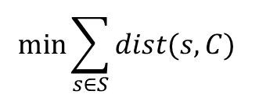
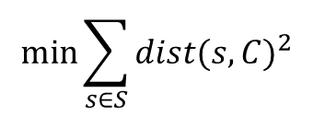
E2
$$min\max_{s∈S}{dist(s,C)}$$
0 1 2 3 4 5 6 7 8 9 10 11 12 13 14 15 16 17 18 19 20
$$min\sum_{s∈S}{dist{(s,C)}^{2}}$$
0 1 2 3 4 5 6 7 8 9 10 11 12 13 14 15 16 17 18 19 20
$$min\sum_{s∈S}{dist(s,C) }$$
0 1 2 3 4 5 6 7 8 9 10 11 12 13 14 15 16 17 18 19 20

Slide 4

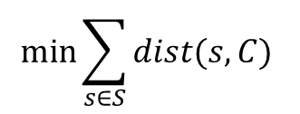
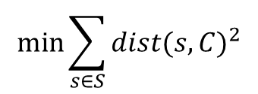
E3
$$min\max_{s∈S}{dist(s,C)}$$
0 1 2 3 4 5 6 7 8 9 10 11 12 13 14 15 16 17 18 19 20
$$min\sum_{s∈S}{dist{(s,C)}^{2}}$$
0 1 2 3 4 5 6 7 8 9 10 11 12 13 14 15 16 17 18 19 20
$$min\sum_{s∈S}{dist(s,C) }$$
0 1 2 3 4 5 6 7 8 9 10 11 12 13 14 15 16 17 18 19 20

Slide 5

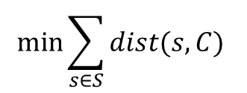
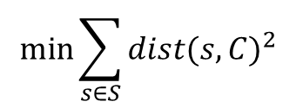
E4
$$min\max_{s∈S}{dist(s,C)}$$
0 1 2 3 4 5 6 7 8 9 10 11 12 13 14 15 16 17 18 19 20
$$min\sum_{s∈S}{dist{(s,C)}^{2}}$$
0 1 2 3 4 5 6 7 8 9 10 11 12 13 14 15 16 17 18 19 20
$$min\sum_{s∈S}{dist(s,C) }$$
0 1 2 3 4 5 6 7 8 9 10 11 12 13 14 15 16 17 18 19 20

Slide 6
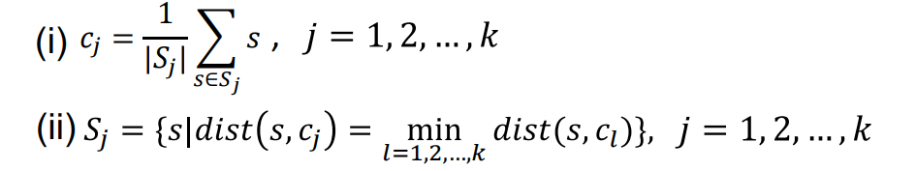
E5
方法There is a drawback in the K-means. The five green points are centers in one iteration process, but no blue points belong to the circled green center makes its horizontal and vertical coordinates nan, and then the result is that we get four centers in the end.

Slide 7
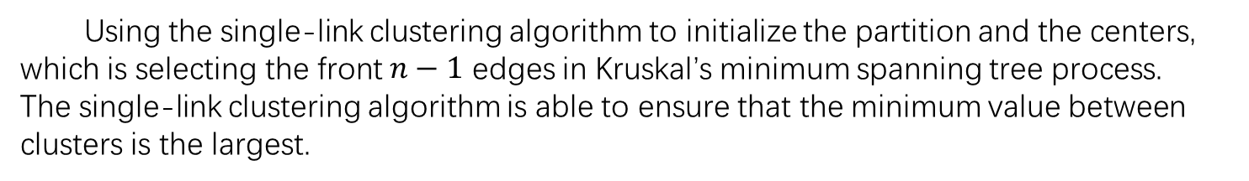

E5
已经Using the single-link clustering algorithm to initialize the partition and the centers, which is selecting the front $n−1$ edges in Kruskal’s minimum spanning tree process.
The single-link clustering algorithm is able to ensure that the minimum value between clusters is the largest.
$Maximize dis\left(c_{k},c_{l}\right)=\min_{s_{i}∈c_{k},s_{j}∈c_{l}}{dis(s_{i},s_{j})}$

Slide 8

E5 Using the single-link clustering algorithm to initialize the partition and the centers.
$$e.g.1$$
Initial points
Single-link
Single-link+K-means

Slide 9

E5 Using the single-link clustering algorithm to initialize the partition and the centers.
$$e.g.2$$
Single-link
K-means

Slide 10
E5 Using the single-link clustering algorithm to initialize the partition and the centers.
$$e.g.2$$
Single-link+K-means
Fuzzy Clustering

Slide 11

E5 Using the single-link clustering algorithm to initialize the partition and the centers.
$$e.g.3$$
Initial points
Single-link

Slide 12

E5 Using the single-link clustering algorithm to initialize the partition and the centers.
$$e.g.3$$
K-means
Single-link+K-means
Fuzzy Clustering

Slide 13
E5
他的Through the comparison of the previous examples, using the single-link clustering algorithm to initialize the partition and the centers is more efficient K-means.

